Slide 1

COVID-19 Outcome Prediction
Dr. Hazem Abbas

Slide 2
Names
Ahmed Mohamed Gaber Abdelaziz ID : 21amga
Karim Gamal Mahmoud Mohamed ID : 21kgmm
Ahmed Ibrahim Salem Abdelhamid ID : 21aisa

Slide 3
Project Description:
The data used in this project will help to identify whether a person is going to recover from coronavirus symptoms or not based on some pre-defined standard symptoms.
These symptoms are based on guidelines given by the World Health Organization (WHO). This dataset has daily level information on the number of affected cases, deaths and recovery from 2019 novel coronavirus.
The data is available from 22 Jan,2020.

Slide 4
Data Preprocessing:
At first, we had discovered our data and we found that the shape of the data is Row 863 Column 14.
There are 13 features and 1 label column (target data ).
By trying several ways to find the best data split ratio.
We found that the feature (symptom 5 & 6 = 3 &1 ) Respectively .
Except for two rows which had the value 1 and 1 respectively and the other one had its value 2 and 0 respectively, so they don't have much change in the training model, but we keep them in the training model as well .

Slide 5
Data Preprocessing (cont.)
We made our models in two ways.
The first way is without one hot encoder and the second one is with one hot encoder.
Because some models have high performance with one hot encoding and some other models
have high performance without one hot encoding, we will discuss that in detail .
we rescale the value of the all data

Slide 6
The Optimal Hyperparameters
We used GridSearchCV to find the optimal hyperparameters .
What is grid search?
It is the process of performing hyperparameter tuning in order to determine the optimal values for a given model .
How did we use it ?
we pass predefined values for hyperparameters to the GridSearchCV function. We do this by defining a dictionary in which we mention a particular hyperparameter along with the values it can take.

Slide 7
Optimal Hyperparameters (cont.)
GridSearchCV tries all the combinations of the values passed in the dictionary and evaluates the model for each combination using the Cross-Validation method.
After using this function, we get accuracy / loss for every combination of hyperparameters, and we can choose the one with the best performance.

Slide 8
1. K-Nearest Neighbors
 | KNN without One Hot Encoding | KNN with One Hot Encoding
Data Splitting | Training = 90 % / Testing = 10 % | Training = 90 % / Testing = 10 %
Hyperparameters | N_Neighbors = 3 | N_Neighbors = 3
 | Metric = 'minkowski' | Metric = 'minkowski'
 | P = 2 | P = 2
 | weights='distance' | weights='distance'

Slide 9
1. K-Nearest Neighbors
Performance | KNN without One Hot Encoding | KNN with One Hot Encoding
Accuracy for training | 100 % | 100 %
Accuracy for testing | 94 % | 94 %
Precision | 0 => 96 % / 1 => 71 % | 0 => 96 % / 1 => 71 %
Recall | 0 = > 97 % / 1 => 62 % | 0 = > 97 % / 1 => 62 %
F1-score | 0 => 97 % / 1 => 67 % | 0 => 97 % / 1 => 67 %
ROC/AUC | 98 % | 91 %
The Best Model : KNN without One Hot Encoding

Slide 10
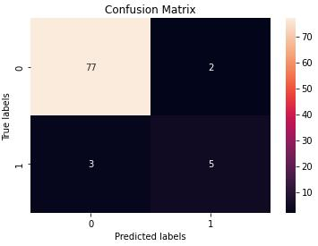
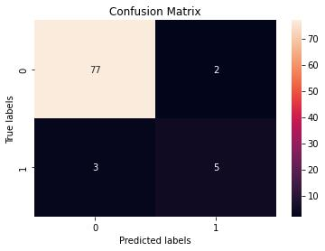
Confusion Matrix
KNN without One Hot Encoding
KNN with One Hot Encoding

Slide 11
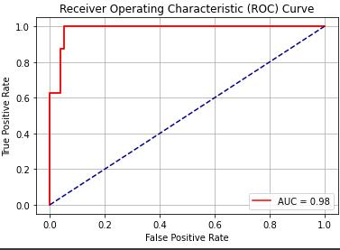
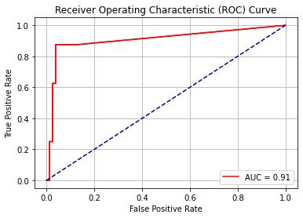
The ROC Curve
KNN without One Hot Encoding
KNN with One Hot Encoding

Slide 12
2. Logistic Regression
 | LR without One Hot Encoding | LR with One Hot Encoding
Data Splitting | Training = 90 % / Testing = 10 % | Training = 84 % / Testing = 16 %
Hyperparameters | penalty = 'l1' | penalty = ‘l2'
 | solver = 'liblinear' | solver = 'newton-cg'
 | C = 5 | C = 1
 | random_state=1 | random_state=3
 | max_iter = 500 | max_iter = 500

Slide 13
2. Logistic Regression
Performance | LR without One Hot Encoding | LR with One Hot Encoding
Accuracy for training | 95 % | 100 %
Accuracy for testing | 94 % | 96 %
Precision | 0 => 96 % / 1 => 71 % | 0 => 98 % / 1 => 81 %
Recall | 0 = > 97 % / 1 => 62 % | 0 = > 98 % / 1 => 87 %
F1-score | 0 => 97 % / 1 => 67 % | 0 => 98 % / 1 => 84 %
ROC/AUC | 97 % | 96 %
The Best Model : LR with One Hot Encoding

Slide 14
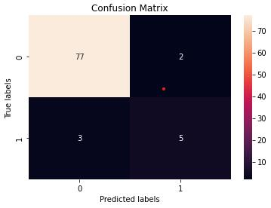
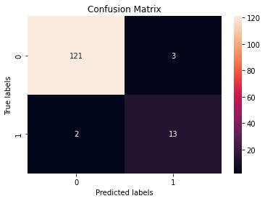
Confusion Matrix
LR without One Hot Encoding
LR with One Hot Encoding

Slide 15
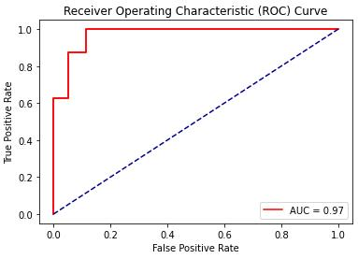
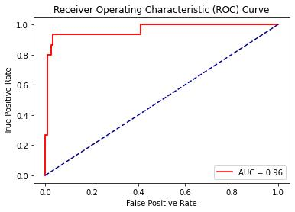
The ROC Curve
LR without One Hot Encoding
LR with One Hot Encoding

Slide 16
3. Naïve Bayes
 | NB without One Hot Encoding | NB with One Hot Encoding
Data Splitting | Training = 90 % / Testing = 10 % | Training = 90 % / Testing = 10 %
Hyperparameters | alpha = 5 | alpha = 1
 | binarize=1, | binarize=1
 | fit_prior = True | fit_prior = True

Slide 17
3. Naïve Bayes
Performance | NB without One Hot Encoding | NB with One Hot Encoding
Accuracy for training | 90 % | 94.2 %
Accuracy for testing | 93 % | 91 %
Precision | 0 => 94 % / 1 => 75 % | 0 => 93 % / 1 => 67 %
Recall | 0 = > 99 % / 1 => 38 % | 0 = > 97 % / 1 => 40 %
F1-score | 0 => 96 % / 1 => 50 % | 0 => 95 % / 1 => 50 %
ROC/AUC | 95 % | 90 %
The Best Model : NB without One Hot Encoding

Slide 18
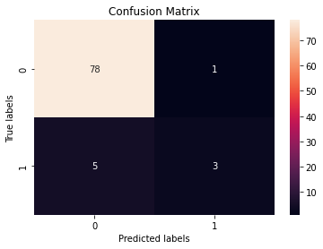
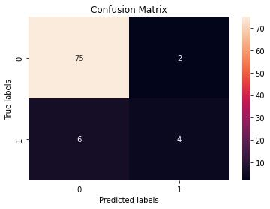
Confusion Matrix
NB without One Hot Encoding
NB with One Hot Encoding

Slide 19
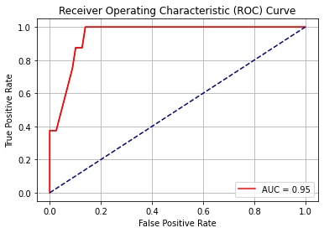
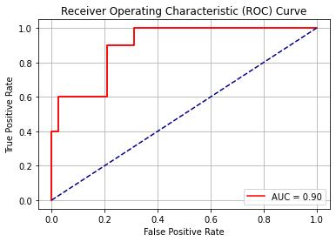
The ROC Curve
NB without One Hot Encoding
NB with One Hot Encoding

Slide 20
4. Decision Trees
 | DT without One Hot Encoding | DT with One Hot Encoding
Data Splitting | Training = 90 % / Testing = 10 % | Training = 90 % / Testing = 10 %
Hyperparameters | criterion= "gini" | criterion= “entropy"
 | max_depth= 9 | max_depth= 16
 | min_samples_leaf= 2 | min_samples_leaf= 1
 | random_state= 3 | random_state= 3

Slide 21
4. Decision Trees *
Performance | DT without One Hot Encoding | DT with One Hot Encoding
Accuracy for training | 98 % | 98 %
Accuracy for testing | 97 % | 97 %
Precision | 0 => 99 % / 1 => 78 % | 0 => 97 % / 1 => 86 %
Recall | 0 = > 97 % / 1 => 88 % | 0 = > 99 % / 1 => 75 %
F1-score | 0 => 98 % / 1 => 82 % | 0 => 98 % / 1 => 80 %
ROC/AUC | 98 % | 98 %
The Best Model : DT without One Hot Encoding

Slide 22


Confusion Matrix
DT without One Hot Encoding
DT with One Hot Encoding

Slide 23
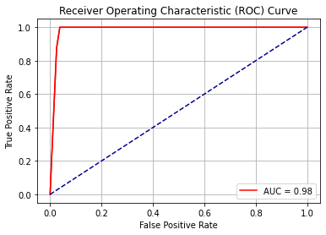
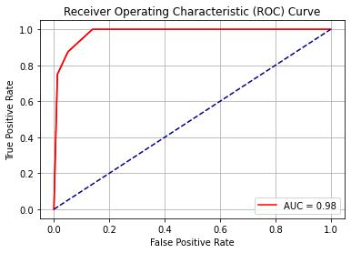
The ROC Curve
DT without One Hot Encoding
DT with One Hot Encoding

Slide 24
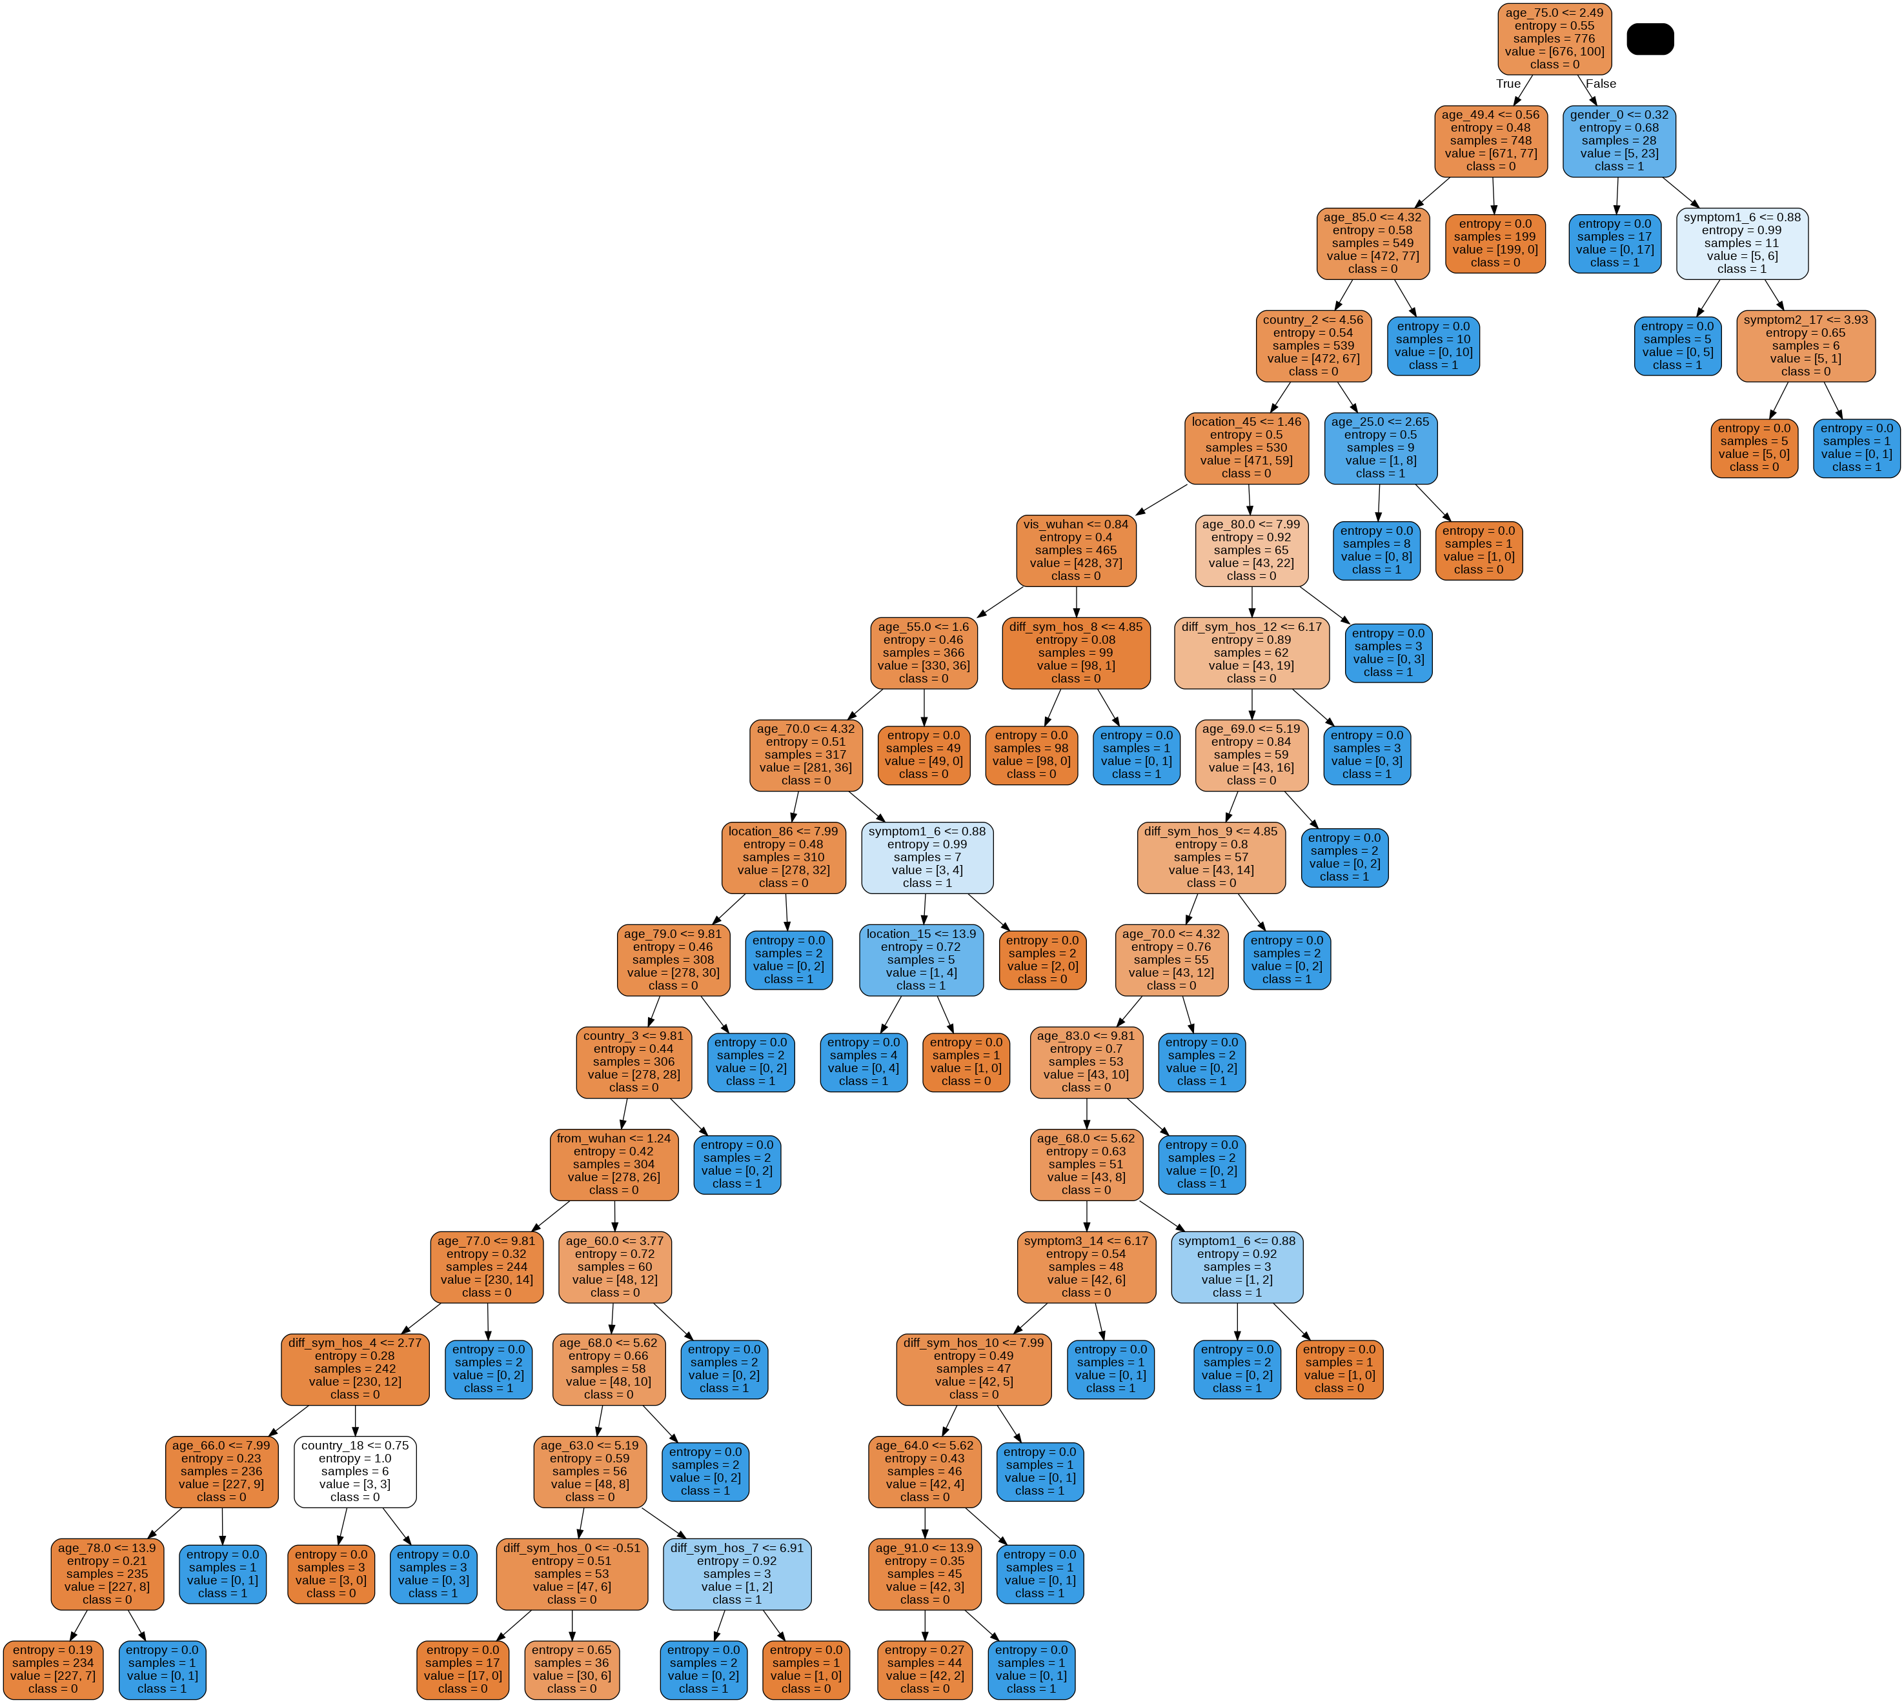
The Visualization for the Tree with Hot Encoding

Slide 25
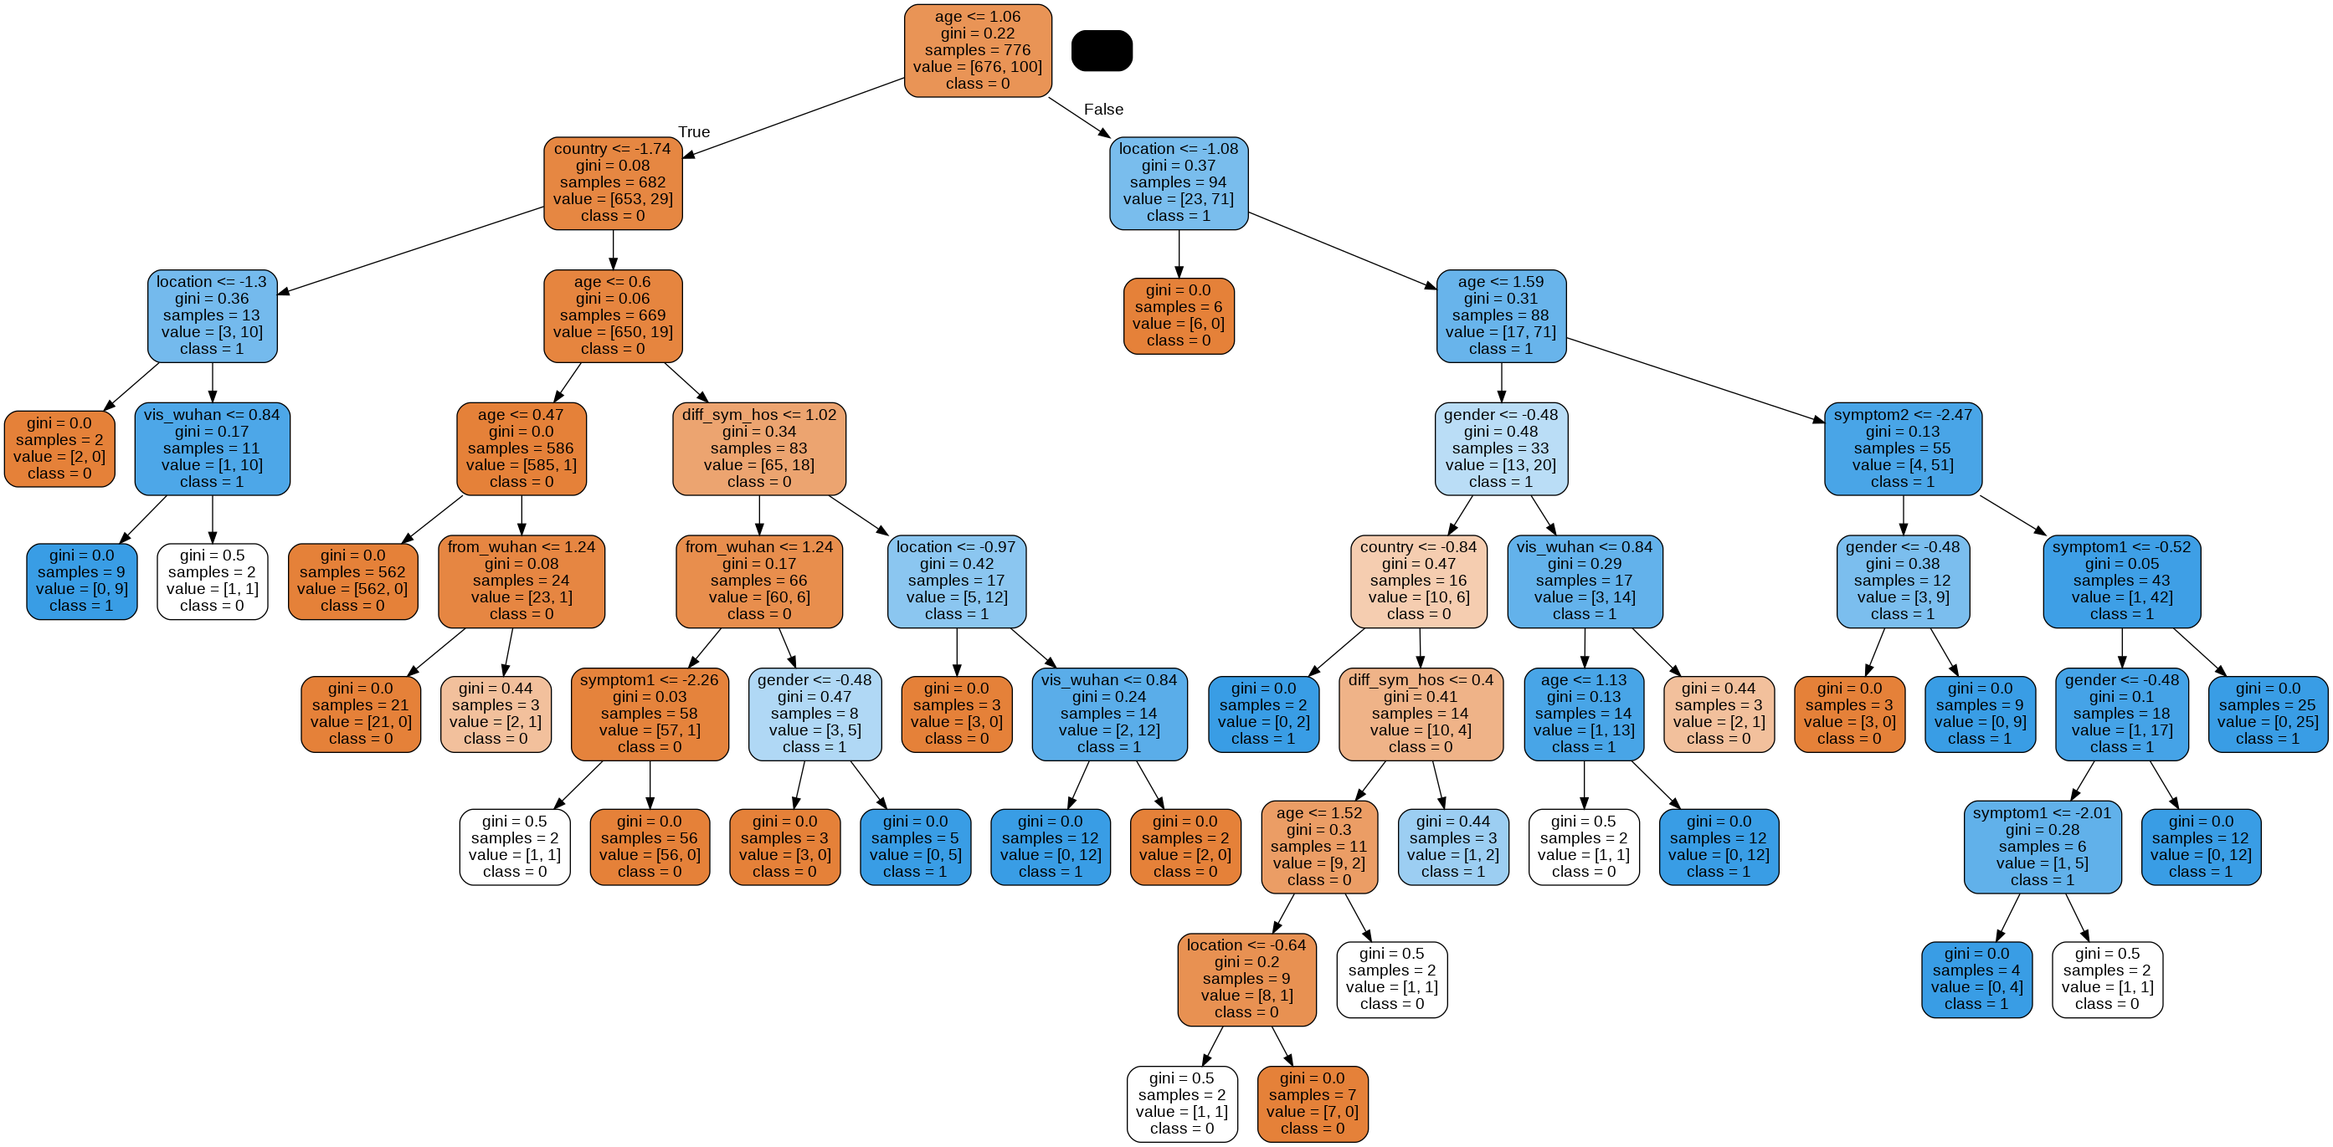
The Visualization for the Tree without Hot Encoding

Slide 26
5. Support Vector Machines
 | SVM without One Hot Encoding | SVM with One Hot Encoding
Data Splitting | Training = 90 % / Testing = 10 % | Training = 85 % / Testing = 15 %
Hyperparameters | kernel = 'rbf' | kernel = ‘rbf'
 | C=100 | C=100
 | gamma=0.01 | gamma=0.001
 | random_state = 0 | random_state = 3
 | probability=True | probability=True

Slide 27
5. Support Vector Machines
Performance | SVM without One Hot Encoding | SVM with One Hot Encoding
Accuracy for training | 98 % | 100 %
Accuracy for testing | 94 % | 96 %
Precision | 0 => 97 % / 1 => 67 % | 0 => 98 % / 1 => 81 %
Recall | 0 = > 96 % / 1 => 75 % | 0 = > 97 % / 1 => 87 %
F1-score | 0 => 97 % / 1 => 71 % | 0 => 98 % / 1 => 84 %
ROC/AUC | 98 % | 98 %
The Best Model : SVM with one hot encoding

Slide 28
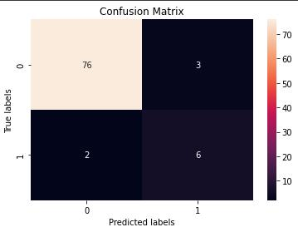

Confusion Matrix
SVM without One Hot Encoding
SVM with One Hot Encoding

Slide 29
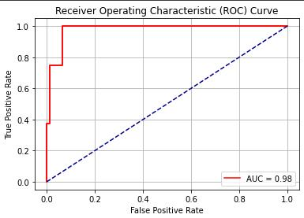

The ROC Curve
SVM without One Hot Encoding
SVM with One Hot Encoding

Slide 30
The Best Model
The good news is that all models are above 90% accuracy.
but we found that the Decision Tree (without one hot encoding) model was the highest one.

Slide 31
The Models From Scratch
Unfortunately in this part we were not able to build the SVM model from scratch but we mentioned
the source of the code that we found.
But the good news is that we built the rest of the four models from scratch.
This is done with the help of some of the resources we mentioned in the Resources slide.

Slide 32

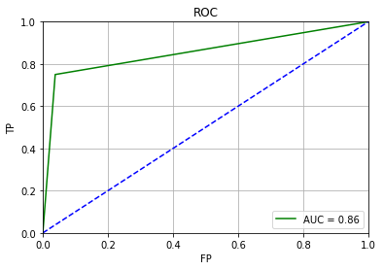
1. KNN From Scratch
Performance | KNN without One Hot Encoding
Accuracy for testing | 94 %
Precision | 0 => 97 % / 1 => 67 %
Recall | 0 = > 96 % / 1 => 75 %
F1-score | 0 => 97 % / 1 => 71 %
ROC/AUC | 86 %

Slide 33
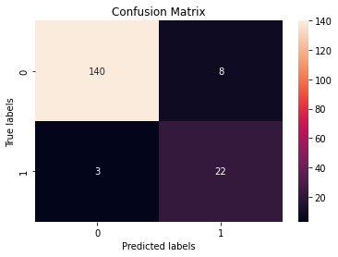
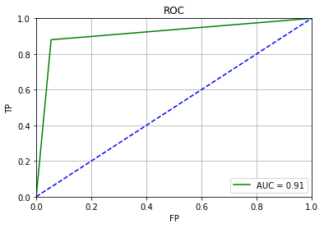
2. Decision Trees From Scratch
Performance | DT without One Hot Encoding
Accuracy for testing | 94 %
Precision | 0 => 98 % / 1 => 73 %
Recall | 0 = > 95 % / 1 => 88 %
F1-score | 0 => 96 % / 1 => 80 %
ROC/AUC | 91 %

Slide 34
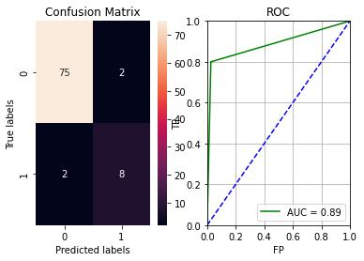
3. Logistic Regression From Scratch
Performance | LR without One Hot Encoding
Accuracy for testing | 95 %
Precision | 0 => 97 % / 1 => 80 %
Recall | 0 = > 97 % / 1 => 80 %
F1-score | 0 => 97 % / 1 => 80 %
ROC/AUC | 89 %

Slide 35
4. Naïve Bayes
The Accuracy for this model was 85%
Unfortunately The Accuracy for this model was very bad.
5. SVM

Slide 36
Resources
Sklearn Documentation
The Github of mlfromscratch
Stackoverflow
scikit-learn package

